Slide 1
Adventurous Dreaming Highflying Dragon: A Full Body Game for Children with Attention Deficit Hyperactivity Disorder (ADHD)
ISMAR 2014

Slide 2
Introduction
1. The Diagnostic and Statistical Manual of Mental Disorders (DSM-IV-TR) reports that 3-7% of school-aged children have ADHD.
2. It is generally accepted that problems with directing and managing attention can impair brain development, task performance in daily living, affect regulation and social functioning.
3. Exercise and play-oriented interventions could improve functioning and decrease symptoms.
4. The design objective for all game-related tasks in this project is to maintain attention while players use different body gestures to control the main character in the game.

Slide 3
System Description
1. Origins of game concept
(1) This project was developed as a student thesis project from within a prominent US game design program.
(2) The game concept was developed through discussions with faculty researchers and clinicians who specialize in adult and pediatric ADHD.
(3) The game tries to incorporate the social integration issue as a theme, and reframes it in a positive way through its story, which may help these children feel good about themselves.

Slide 4
System Description
2. Description of prototype(Three mini-games)
(1) Forrest
(a) It provides a practice space for attention and aims to increase the ability to focus and remember specific visual prompts.
(b) The game asks players to memorize a certain sequence of desired objects.
(c) Then the player has to match and catch the required object with their body while different objects appear within different color trees.

Slide 5
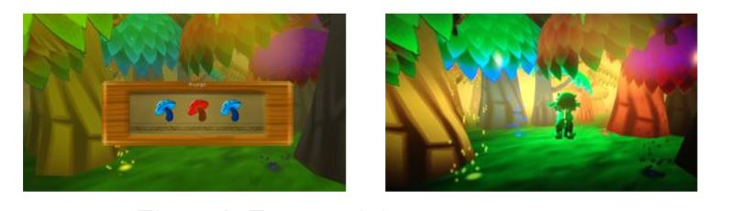

Slide 6
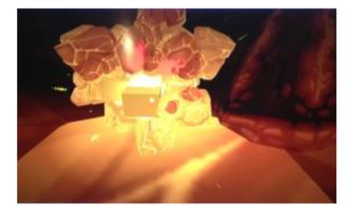
System Description
2. Description of prototype(Three mini-games)
(2) Cave
(a) It provides a practice space to enhance gross and fine motor skills.
(b) The player as a little dragon has to be careful with their big claws while breaking pieces of rock to get to the precious core whose location is not predictable.

Slide 7
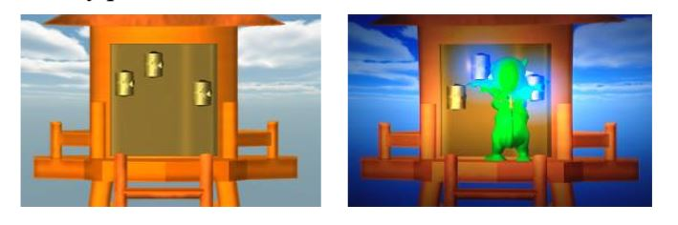
System Description
2. Description of prototype(Three mini-games)
(3) Water Tower
(a) It trains the ability to hold still on one pose.
(b) The player is asked to put any part of their body on the cracks to avoid any expansion of cracks, and to hold the pose for few seconds to heal the water tower.

Slide 8
Assessing Upper Extremity Motor Dysfunction Using an Augmented Reality Game
ISMAR 2017

Slide 9
Introduction
1. It becomes a necessity to develop cost-effective evaluation methods for diagnosis, treatment and monitoring of patients with motor dysfunctions.
2. The clinical community needs improved assessment methods to provide objective and quantitative measurements of human motor function in a controlled and challenging environment that offers the possibility to perform a variety of movements.
3. VR enables real-world situations to be simulated, thereby giving the therapist full control over parameters. The total visual isolation from the real world, however, may interfere with natural behaviour of patients.

Slide 10
Introduction
4. This issue can be circumvented by using AR, which allows the user to see the real world, with virtual objects superimposed upon or composited with the real world.
5. Interactive AR systems have already been successfully developed for rehabilitation of motor function of the arm and hand.
6. Research to date has not focused on the use of virtual environments for objective assessment of the type and severity of arm and hand dysfunction.

Slide 11
Study Design
1. “Post Office Trouble” Game design
(1) Hardware: AIRO II HMD, Kinect, Intel RealSense F200.
(2) Software: Unity3D
(3) The game puts a player in the position of a post office worker who has to sort packages and put them into the target boxes.
(4) In each round (three rounds in total) the patient should to grasp the package that appears in the centre of the marker (using the thumb and index finger) and move it towards its correct destination box.
(5) The “correct” destination box is determined by the image displayed on the side of the package that initially faced the user or the color of the package.

Slide 12
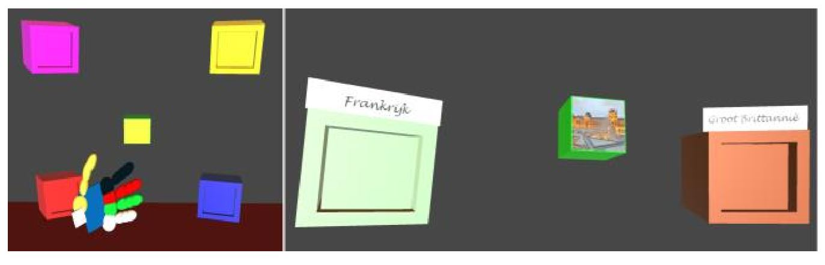

Slide 13
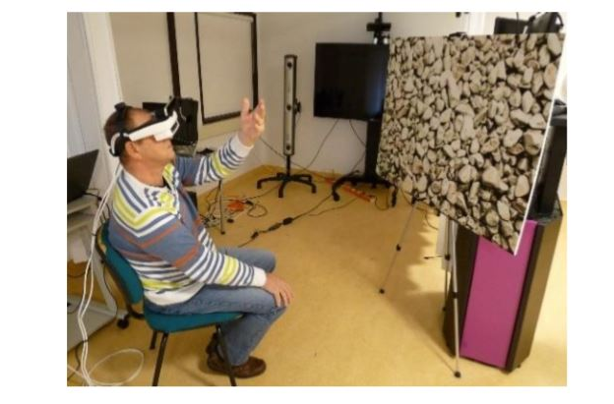

Slide 14
Study Design
2. Participants
(1) 10 PD patients(scoring 1 to 3 on the item “block 5 cm” of the Action Research Arm Test)
(2) 10 stroke patients(Time since infarct or haemorrhage ranged from 1 to 8 years)
(3) None of the participants had used a HMD before and they had no experience with a natural user interface(NUI).

Slide 15
Study Design
3. Outcome measure
(1) NASA-TLX Questionnaire (task load)
(2) System Usability Scale (the usability of our AR system)
(3) Game Experience Questionnaire (engagement of the participants)
(4) timeInteraction, timeNoInteraction, timeHandLost (task performance and execution in AR)
(5) 3D positional of “body points” and “hand joints” (movement characteristics)
(6) Total duration (the reaching movement in AR and the real world)
(7) The elbow angle(the angle between the upper arm and the lower arm) and the upper arm angle(the angle of the upper arm relative to the horizontal plane)
(8) The maximum absolute angular velocity of the elbow and upper arm
(9) The maximum absolute velocity of the wrist and trunk

Slide 16
Study Design
3. Outcome measure
(10) The total length of the trajectory transversed by the wrist(the “directness” of the movement from start to target position)
(11) The linear distance between the tip of the thumb and the index finger
(12) Trunk displacement
(13) The number of packages moved into the correct destination box(performance)

Slide 17
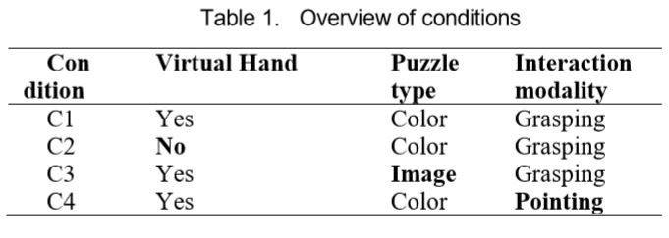
Study Design
4. Conditions
(1) Study was conducted in 4 conditions and real world.

Slide 18
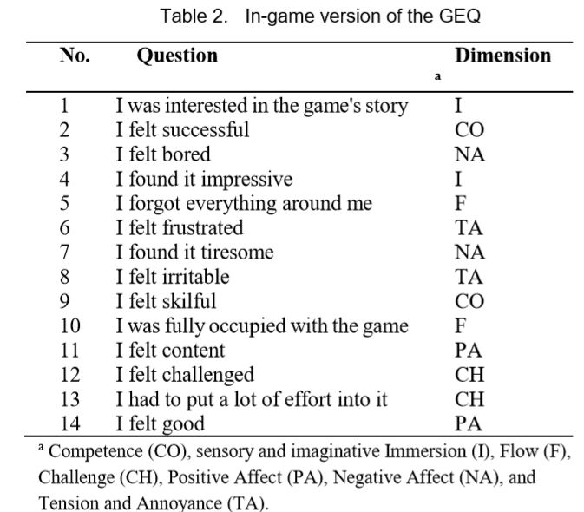

Slide 19
Results
1. For all AR conditions, usability scores of individual patients and significant correlations between usability and GEQ.
2. As 76% of the SUS scores in Table 3 are below the threshold value 68, usability still needs to be improved.

Slide 20
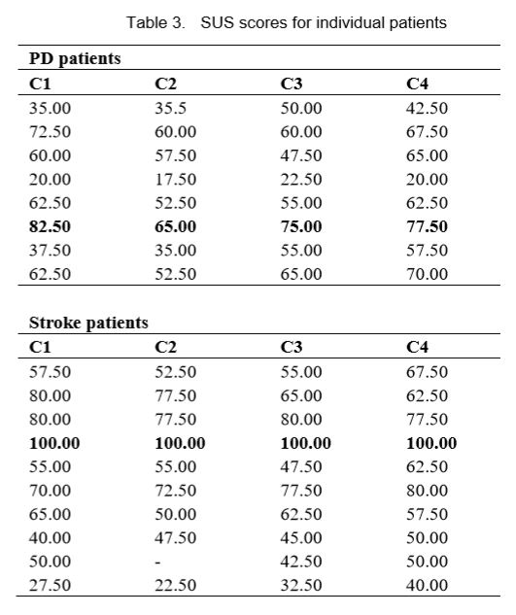

Slide 21
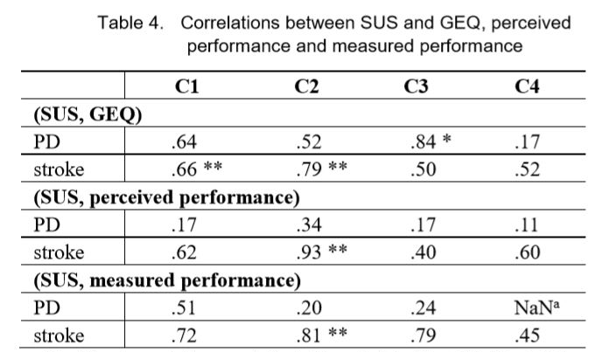

Slide 22
Results
3. The use of an image-based puzzle (instead of colors) thus had no significant effect on movement characteristics.
4. Movements in AR took much longer than in the real world and were associated with lower maximum velocity of the upper arm, wrist and trunk.
5. No significant correlations were observed between characteristics of movements in AR C1 and movements in the real world.
6. For the both patients, providing visual feedback for the hand helped them to have better hand recognition.

Slide 23
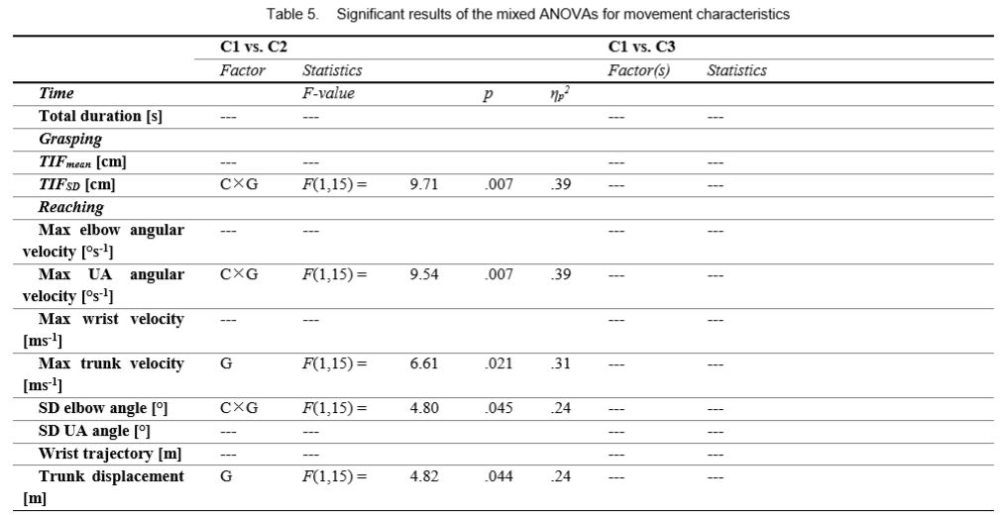

Slide 24
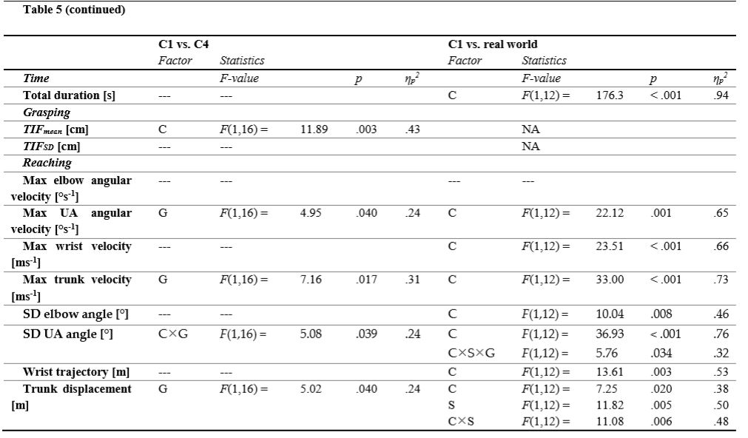

Slide 25
Conclusion
1. A comparison of movement characteristics revealed that moving a real object was more targeted and took less time than moving a virtual object.
2. No significant correlations were observed between characteristics of movements in AR and movements in the real world.
3. Despite usability issues mainly due to non-robust hand tracking, the patients were moderately engaged while playing the AR game.
4. AR game may be suitable for assessing the hand and arm function of mildly affected patients if usability can be further improved.

Slide 26
Limitations
1. The usability of our AR system was relatively low.
2. For OST-HMD, the optimal position for hand recognition was with the palm oriented towards the HMD, which was experienced as a relatively unnatural position to grasp the package.
3. The associated postures of the head and hand were difficult for some of the more affected patients.

